Slide 1
Mumbai
Battle of Neighborhoods – Week 5

Slide 2
A description of the problem and a discussion of the background:
Deciding upon ideal location to opening a Chinese restraint in Mumbai
Mumbai, formerly Bombay, city, capital of Maharashtra state, southwestern India. It is the country’s financial and commercial centre and its principal port on the Arabian Sea. Mumbai is the capital city of Maharashtra. It is one of the largest metropolitan areas in the world and India’s economic centre. The country's most important seaport, the Jawaharlal Nehru Port, is also located here. It is one of the largest natural ports worldwide and has become one of the most significant transfer sites at the Arabian Sea. The megacity generates more than a quarter of Maharashtra’s gross domestic product. Apart from that, almost half of the Indian foreign trade is transacted here. The economically most significant branches are the finance, cotton, chemical, car and electronics industry.
Mumbai attracts people from all over the India and the world at large. Understandably there are many restaurants in the City, each belonging to different categories like Chinese , Italian , French etc. As a part of this project I will try to help my client who is looking to open a restaurant, where would you recommend that they open it?

Slide 3
Key Questions to be answered
•What is best location in Mumbai City for Chinese Cuisine ? •Which areas have large number of Chinese Resturant Market ? •Which all areas have less number of resturant ? •Which is the best place to stay if I prefer Chinese Cuisine ? •What places are have best restaurant in Mumbai?
What is best location in Mumbai City for Chinese Cuisine ?
Which areas have large number of Chinese Resturant Market ?
Which all areas have less number of resturant ?
Which is the best place to stay if I prefer Chinese Cuisine ?
What places are have best restaurant in Mumbai?

Slide 4
Data
On Restaurants: Kaggle Zomato: This data set contains the required information. And we will use this data set to explore various locality of Mumbai.
On Nearby places: Foursquare: Using this api we will get all the venues in each neighborhood

Slide 5
Methodology
List item-•Using FourSquare find all venues for each neighborhood in Mumbai
List item-Filter out all venues that are nearby by locality.
Using aggregative rating for each resturant to find the best places.
Visualize the Ranking of neighborhoods using folium library(python)

Slide 6
Results

Slide 7
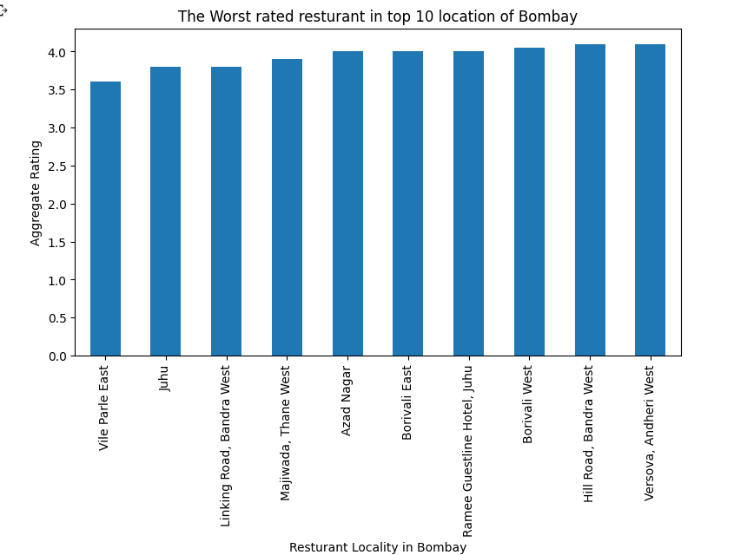

Slide 8
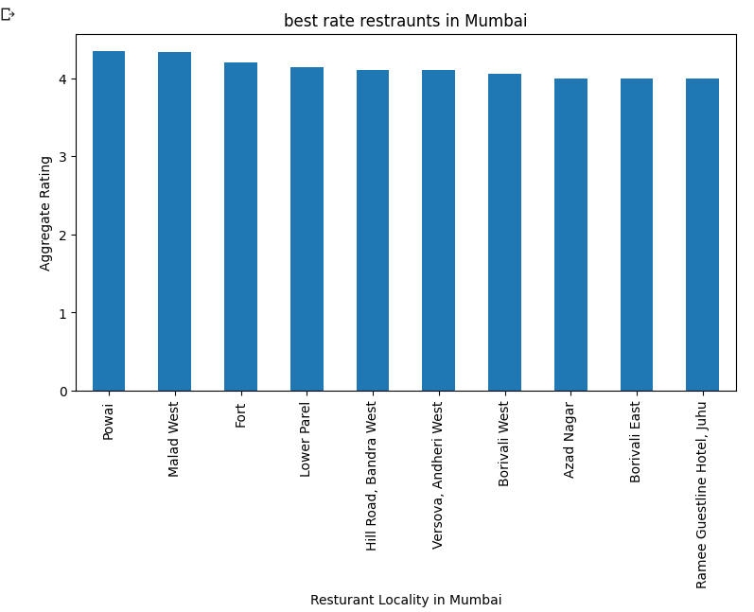

Slide 9
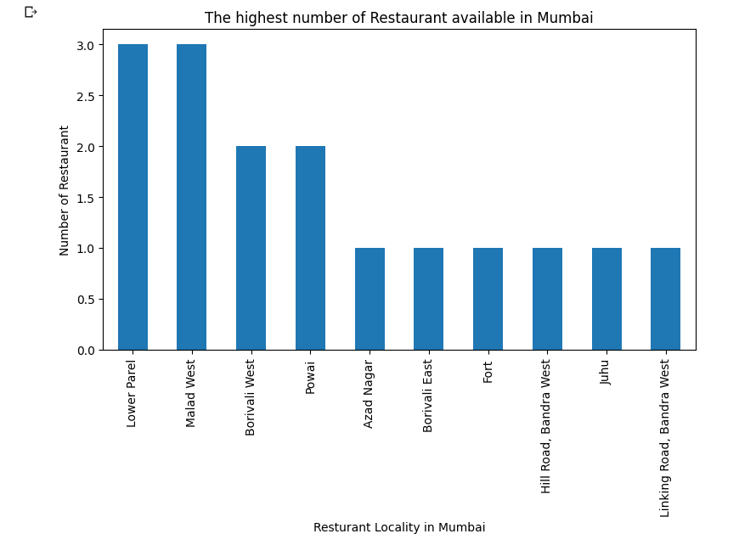

Slide 10
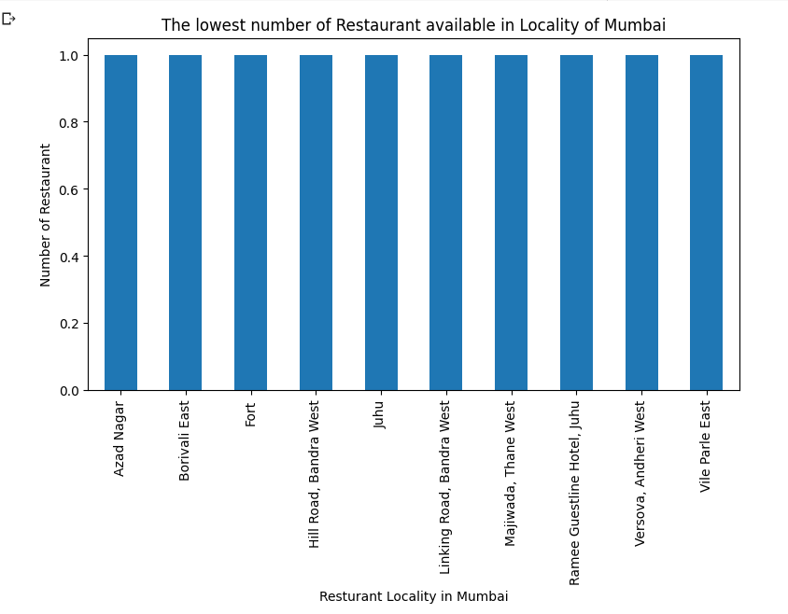

Slide 11
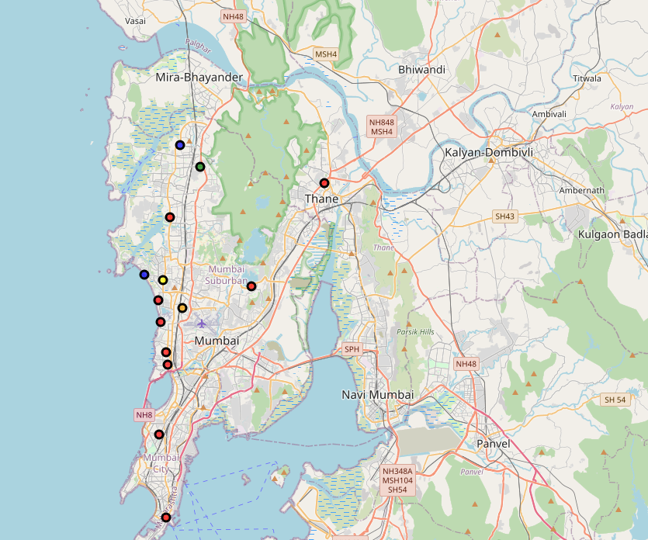

Slide 12
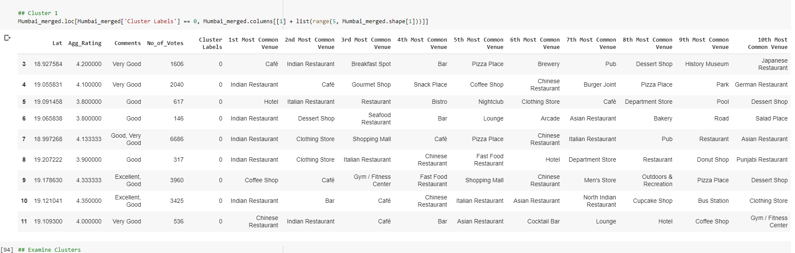
Cluster 1

Slide 13
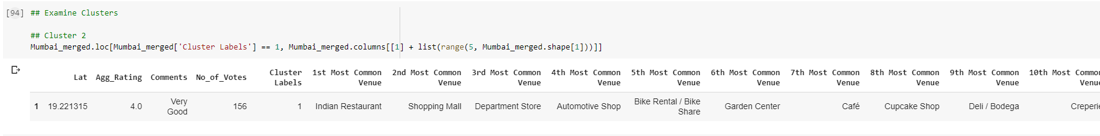
Cluster 2

Slide 14
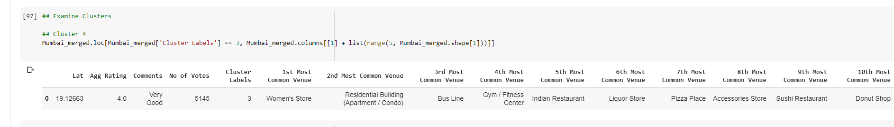
Cluster 3

Slide 15
Cluster 4

Slide 16
Vile Parle and Juhu have worst restraunt
Vile Parle and Juhu have worst restraunts
Vile Parle and Juhu have worst restraunt
Powai and Malad have best Restaurants
Vile Parle and Juhu have worst Restaurants
Biggest number of Restaurants are in Lower Parel and Malad. This is the best place for foodie to live
Cluster 1 is most recommended for Indian Cuisine
Cluster 2 is good for Caffe
Cluster 5 is not recommended
Chinese restraint should choose between cluster 1 and 2

